Slide 1
Data analysis

Slide 2
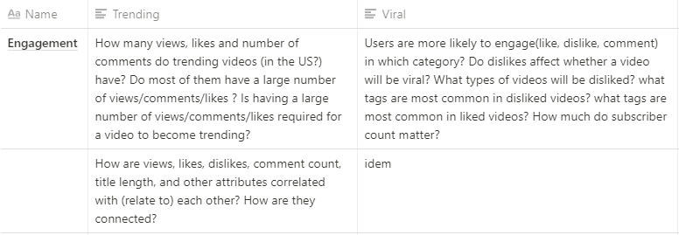

Slide 3
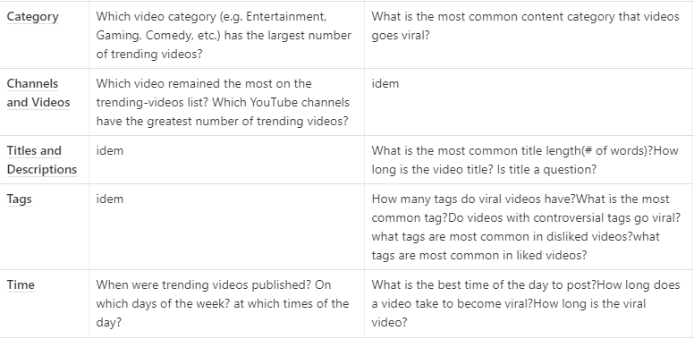

Slide 4
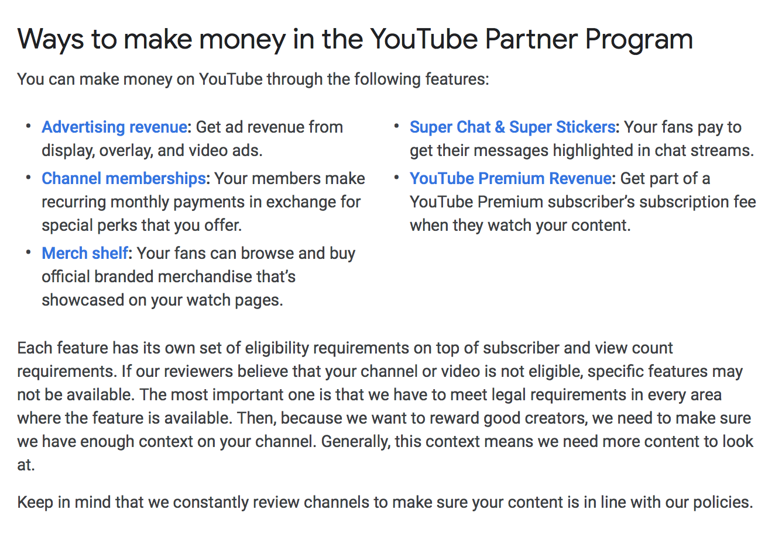

Slide 5
Viral dataset -
US only or world?
This dataset has ? videos

Slide 6
Our hypothesis: Viral videos can become viral whether they are massively liked or disliked, in other words viral videos are videos that create a reaction in the viewer.

Slide 7
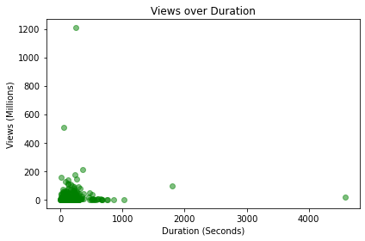
Notes:
keep

Slide 8
Why did we choose this visualisation:
We chose a scatter plot since it is the most effective way of visualising the information, and identifying clusters.
What can we see:
Cluster in bottom left
None greater than 16.6 min in duration
Most viral videos have a duration of 500 s or lower (8.33 min or lower)
What are the limitations:
Mention that views come after the video gets viral

Slide 9
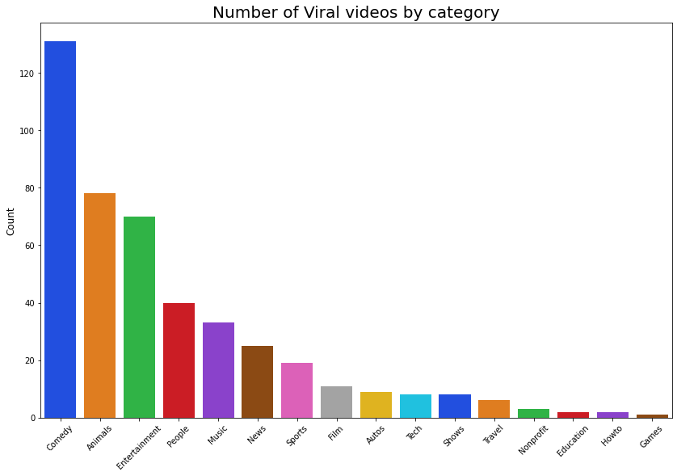
Note: this is the same as slide 5 but presented differently
Notes:
keep

Slide 10
Why did we chose this visualisation:
We chose a line graph to compare which categories have the most number of videos for trending and viral videos.
What can we see:
Top 3 categories: Comedy, Animals, Entertainment
Bottom 3 categories: Games, How to, Education
Viral video are funny
A video is more likely to go viral if its content is entertaining/fun/cute rather than pedagogical. One could argue it is easier for something “fun” to go viral: no debates/explications/need to focus required, quicker to share thus to go viral.
Animals category is very highly represented in viral videos, proportionally much more compared to trending videos.
‘How to’ and style category is almost not represented among viral videos, but is very high in the number of trending videos.
We hypothesise this is because of partnerships
What are the limitations:
Comedy and Entertainment categories are similar. Entertainment includes dance, talk shows.
Scale of line graphs is not the same, this is because there is not the same amount of videos in the viral and trending datasets.

Slide 11
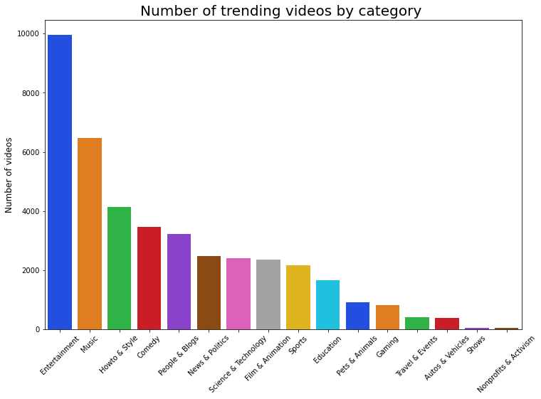
Note: this is the same as slide 15 but presented a bit differently
Notes:
keep

Slide 12
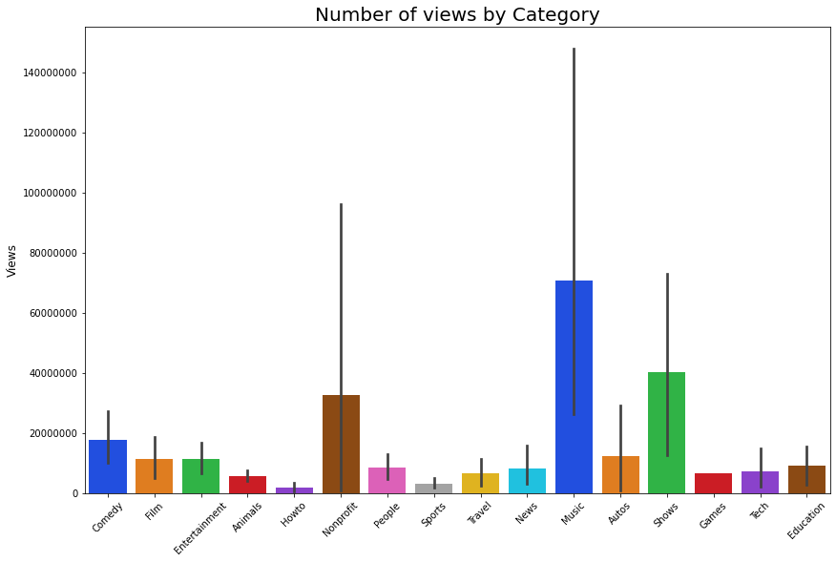
Note: same as slide 7

Slide 13
Why did we chose this visualisation:
What we can see:
The music category has the most views. This might be due to some of YouTube’s most viewed videos like Gangnam Style, belonging to that category, .
Shows have high numbers of views, although they do not have as many videos uploaded.
Non profit category also has high number of views.
What does the Nonprofit category mean? All non-remunerated videos, activism.
https://techpostplus.com/youtube-video-categories-list-faqs-and-solutions/
What are the limitations:

Slide 14
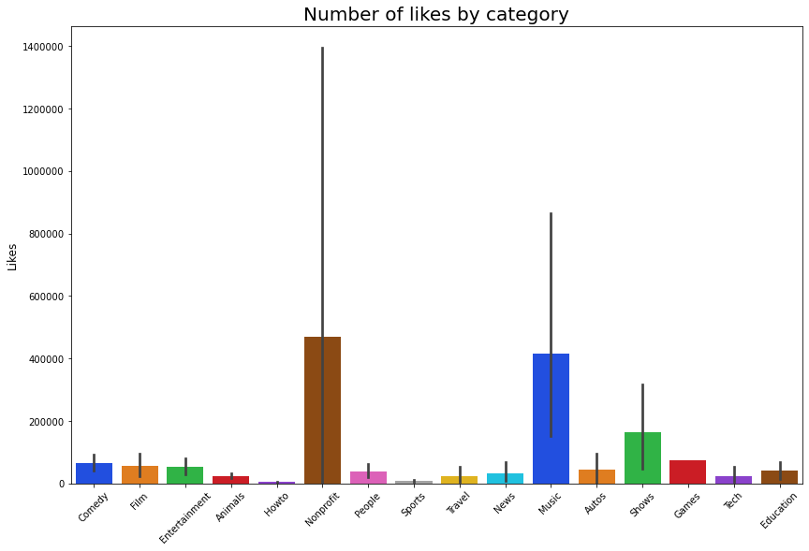

Slide 15
Why did we chose this visualisation:
What we can see:
What are the limitations:

Slide 16
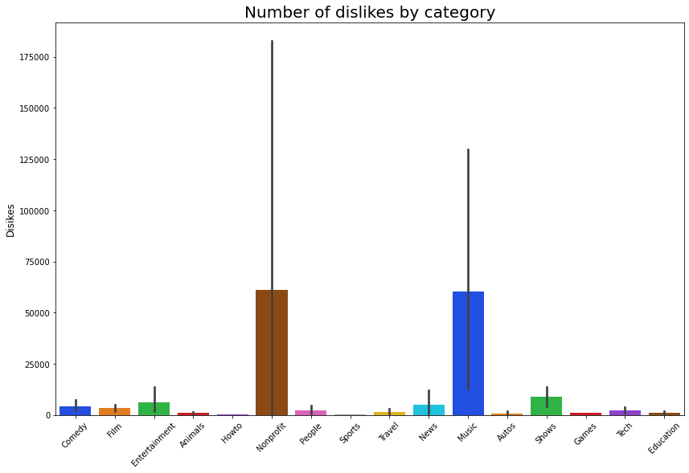

Slide 17
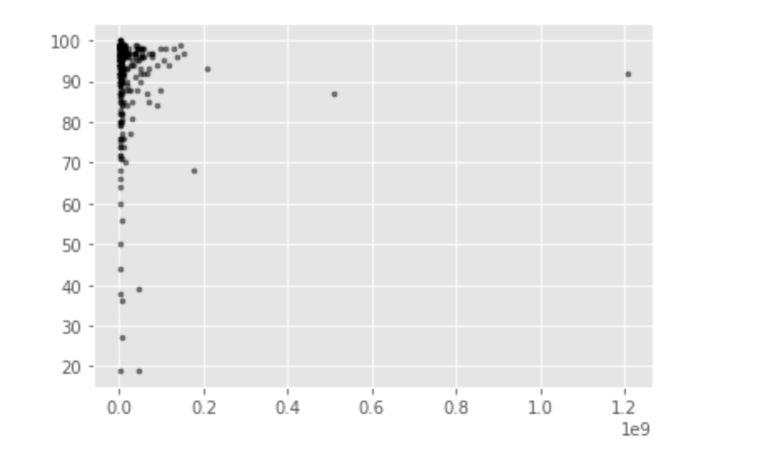
Viral
Number of Likes
Views

Slide 18
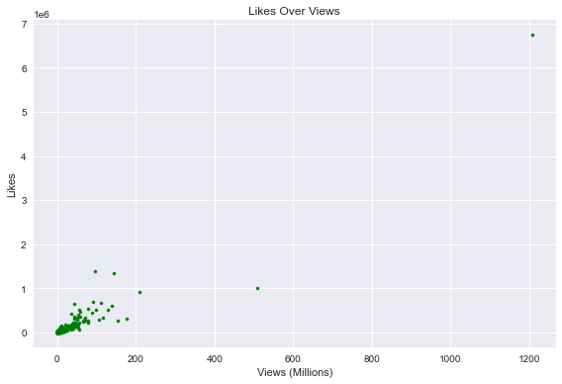
Viral

Slide 19
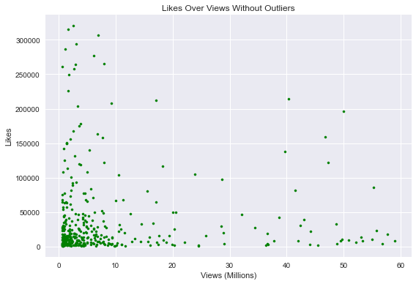
Viral
Notes:
Philippine

Slide 20
Following this, the percentage of likes was plotted against the views for the viral video’s dataset. Looking at it, a few things become clear. First of all, it is more than clear that the vast majority of the viral videos in the data set had an overwhelmingly high percentage of likes and therefore, a positive sentiment by the audience. More specifically, it seems as if the top videos in the viral dataset had around 95% of likes. These reached the millions of views. However, it should also be noted that those videos which didn’t go as viral (those with less than half a million views) did not all have a low percentage of likes. These are still accumulated between 90 and 80 % of likes. This emphasizes that though the majority of very viral videos had a very high percentage of likes, having a high percentage of likes does not guarantee virality. There is a random variable that the creator must take into account. Just because your video has a high and positive overall sentiment by the audience this does not guarantee virality. This is further highlighted by the equal distribution of the videos with less than one million views across the x-axis. However, looking at this the creator should note that if they have a low percentage of likes, their probability of going viral decrease greatly as no videos below a like percentage of 60% in the dataset attained more than 5 million views.

Slide 21
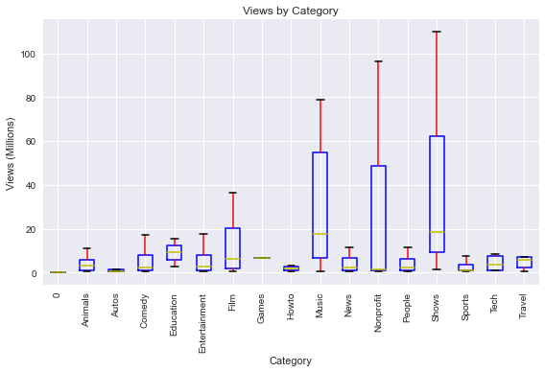
Jorge
Notes:
keep

Slide 22
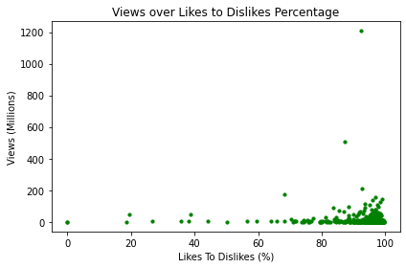
Notes:
keep

Slide 23
Why did we choose this visualisation:
What we can see:
Most viral videos have over 80% of likes, however some viral videos also have a majority of dislikes. So you can get viral with videos that create bad buzz, but we advise you to create videos that will have likes.
Most outliers (videos with the most views) still have over 80% of likes.
What are the limitations:

Slide 24
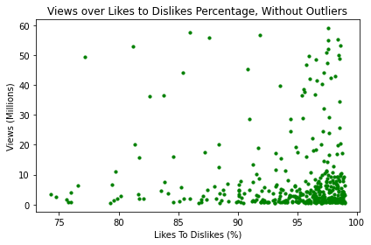

Slide 25
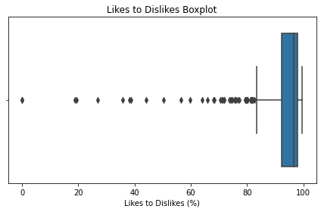
Notes:
keep

Slide 26
Why did we choose this visualisation: Boxplot is a good way to see the repartition of the data, as well as the outliers.
What we can see:
Here we notice the repartition is quite concentrated above 80% of likes, but there are still outliers (videos that had a particularly high percentage of dislikes)
Viral videos in general have more likes than dislikes.
.
What are the limitations:

Slide 27
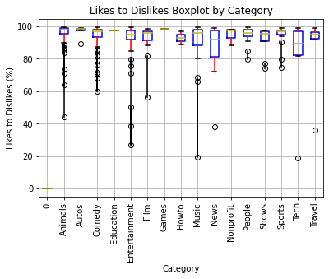
Notes:
keep

Slide 28
Why did we choose this visualisation: Boxplot is a good way to see the repartition of the data, as well as the outliers.
What we can see:
Entertainment and music have the greatest amount of outliers -> why?
.
What are the limitations:

Slide 29
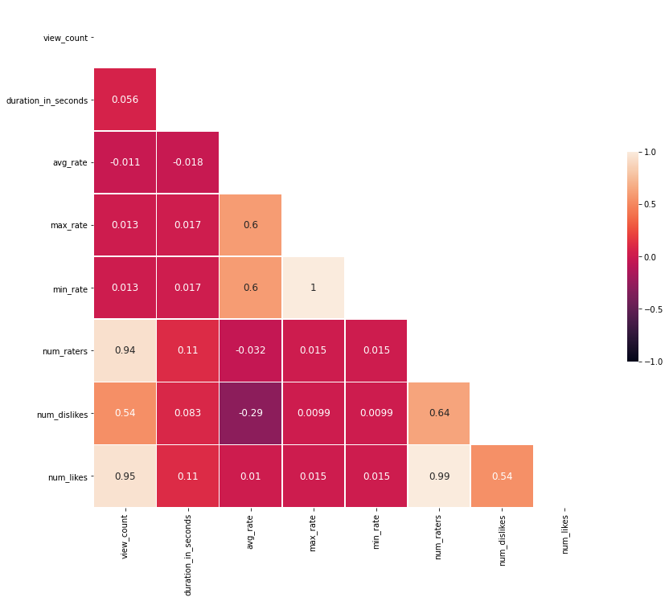
Notes:
keep

Slide 30
Why did we choose this visualisation: Boxplot is a good way to see the repartition of the data, as well as the outliers.
What we can see:
The highest positive correlation is between likes and views with a value of 0.85.There is also a significant positive correlation between the number of comments and the number of likes, and the number of comments and dislikes.
There is a positive correlation yet less significant between the number of comments and views, dislikes and views and dislikes and likes.
Since there is a high positive correlation between between likes and views, we want to examine their relationship in greater depth by plotting a scatter plot between these variables.
What are the limitations

Slide 31
Trending Dataset (1)
US only
This dataset has 40949 videos

Slide 32
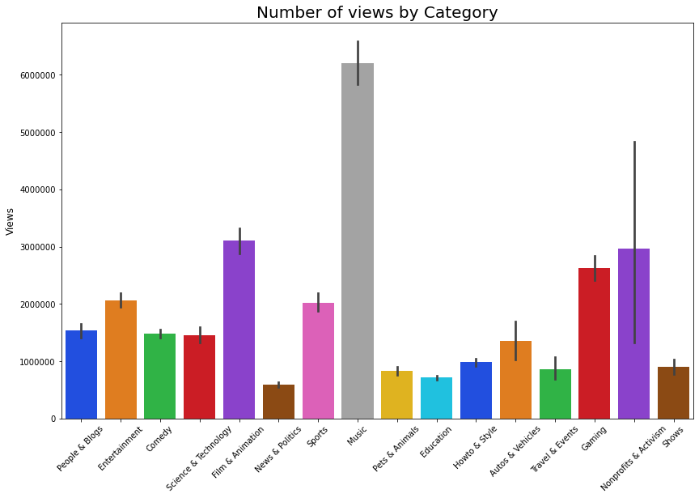

Slide 33
We observe that the number of views is much more equally distributed across categories.
The categories watched in trending videos are more varied than in viral videos. We hypothesise that this is due to the YouTube algorithm selecting videos to become trending among all categories.

Slide 34
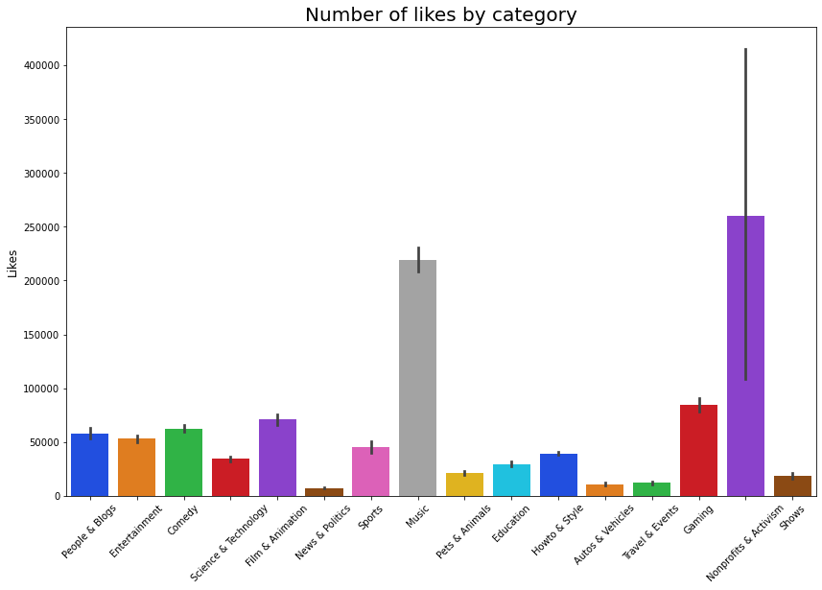

Slide 35
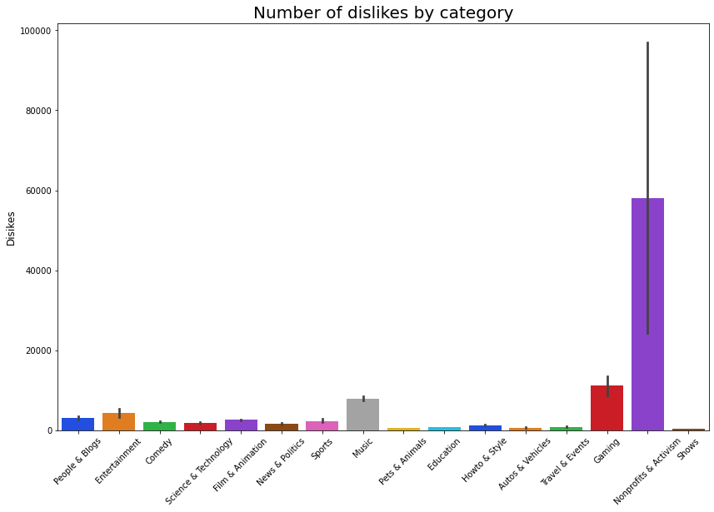

Slide 36
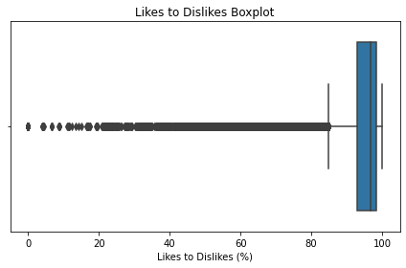

Slide 37
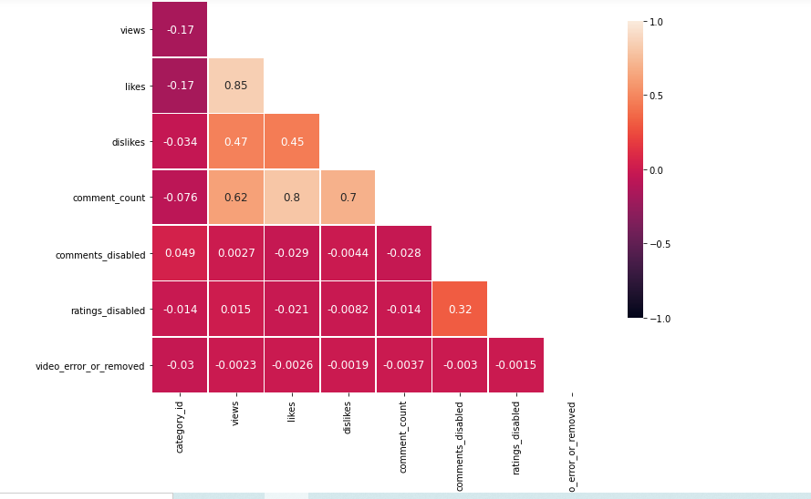
Correlation heatmap for the US trending videos
The highest positive correlation is between likes and views with a value of 0.85.There is also a significant positive correlation between the number of comments and the number of likes, and the number of comments and dislikes.
There is a positive correlation yet less significant between the number of comments and views, dislikes and views and dislikes and likes.
Since there is a high positive correlation between between likes and views, we want to examine their relationship in greater depth by plotting a scatter plot between these variables.
Notes:
The highest positive correlation is between likes and views with a value of 0.85.There is also a significant positive correlation between the number of comments and the number of likes, and the number of comments and dislikes.
There is a positive correlation yet less significant between the number of comments and views, dislikes and views and dislikes and likes.
keep

Slide 38
Trending Dataset (2)
US only
This dataset has 4547 trending videos

Slide 39
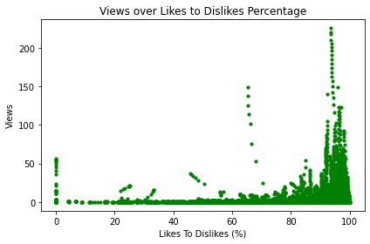

Slide 40
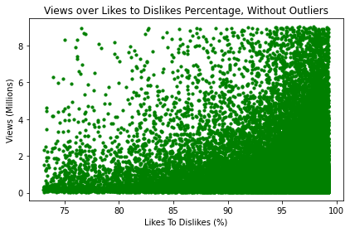

Slide 41
Compared to the viral one, we can see with this scatter plot that the percentage of likes is more varied. There isn’t a cluster from 80, but more of a block that starts at 70% and rises. This means that as the percentage of likes increases, so does the number of views.

Slide 42
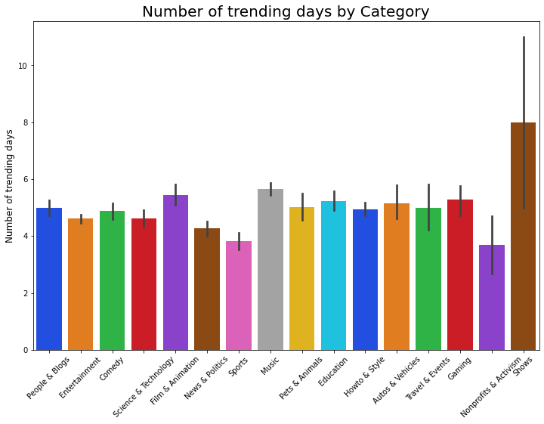

Slide 43
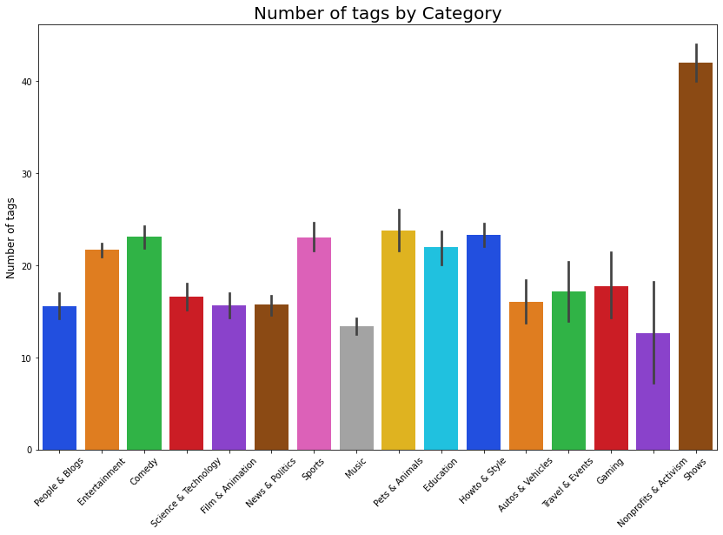

Slide 44
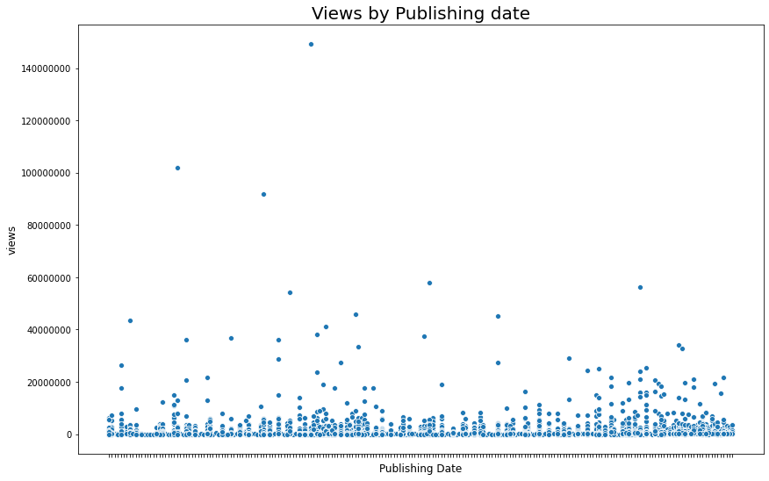
To edit for greater clarity

